Slide 1
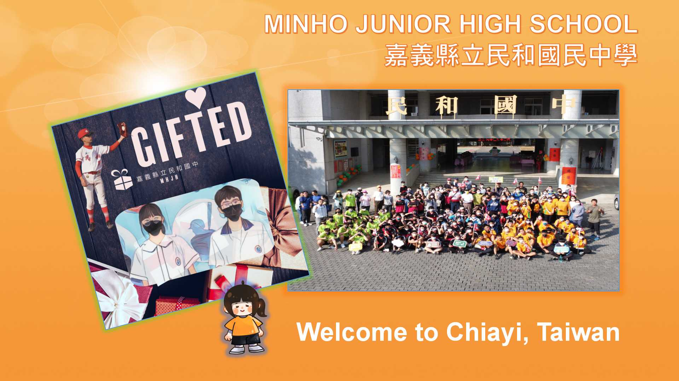
Section Chief of Curriculum 教學組長 李俐宛
Miranda Li

Slide 2
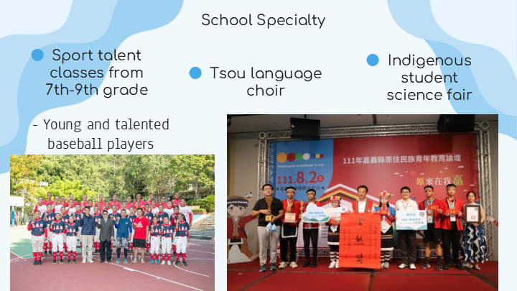
學校特色介紹 (影片介紹)

Slide 3

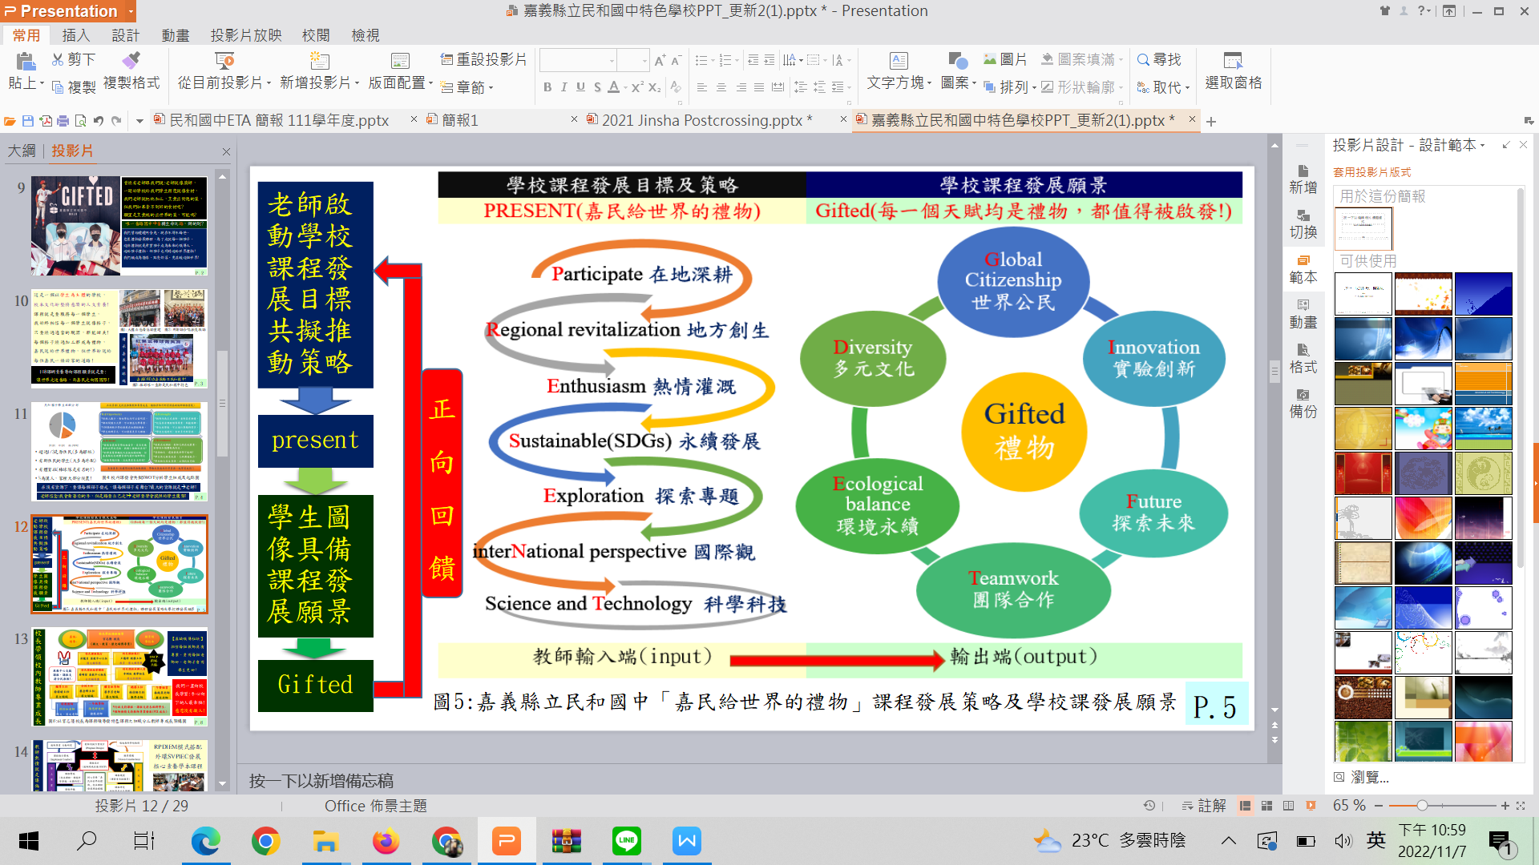

Slide 4





2022~2023
111學年度補助公立國民中小學與國外姐妹校互惠機制實施計畫
Minho Junior High School Taiwan
National Victor Public School India

Slide 5
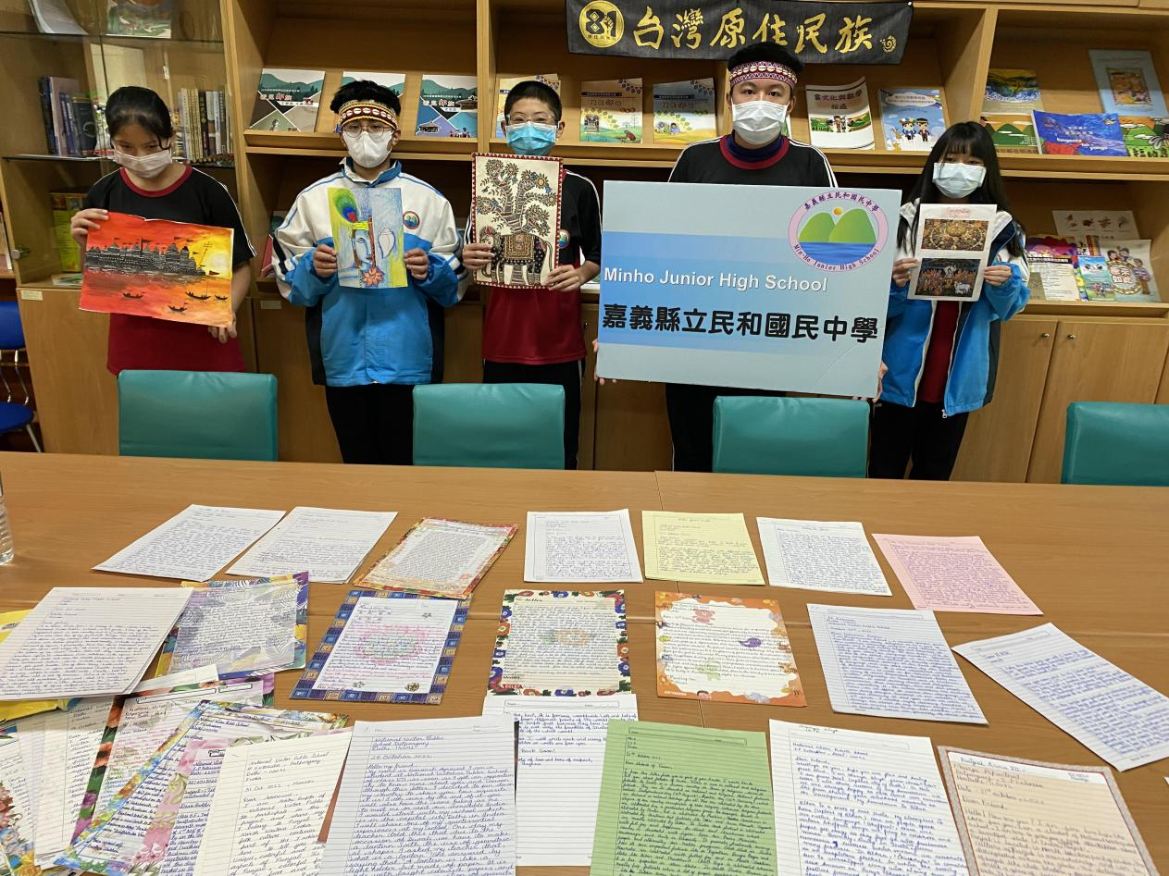
Postcrossing Project
學生收到了描述印度文化、宗教、歌舞、繪畫、觀光以及美食等各方面的書信，也收到令人驚豔的在地藝術創作!
Special Thanks to ...
Principal
Veena Mishra

Slide 6
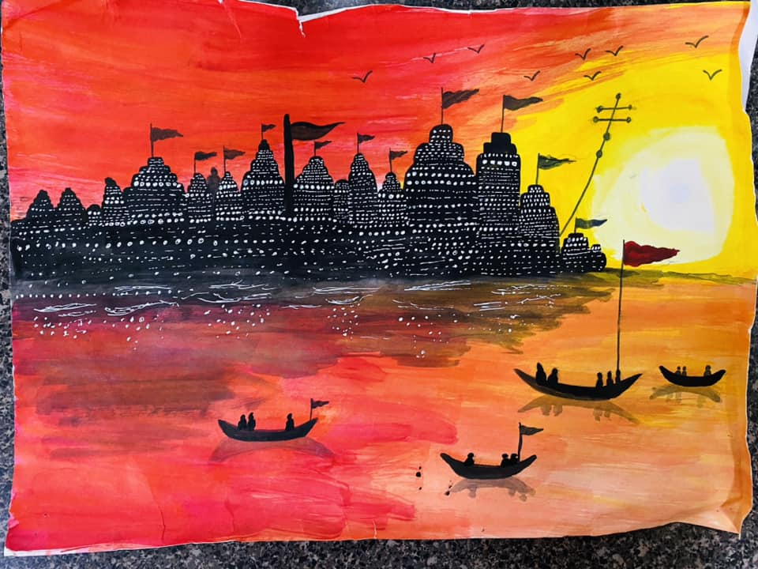
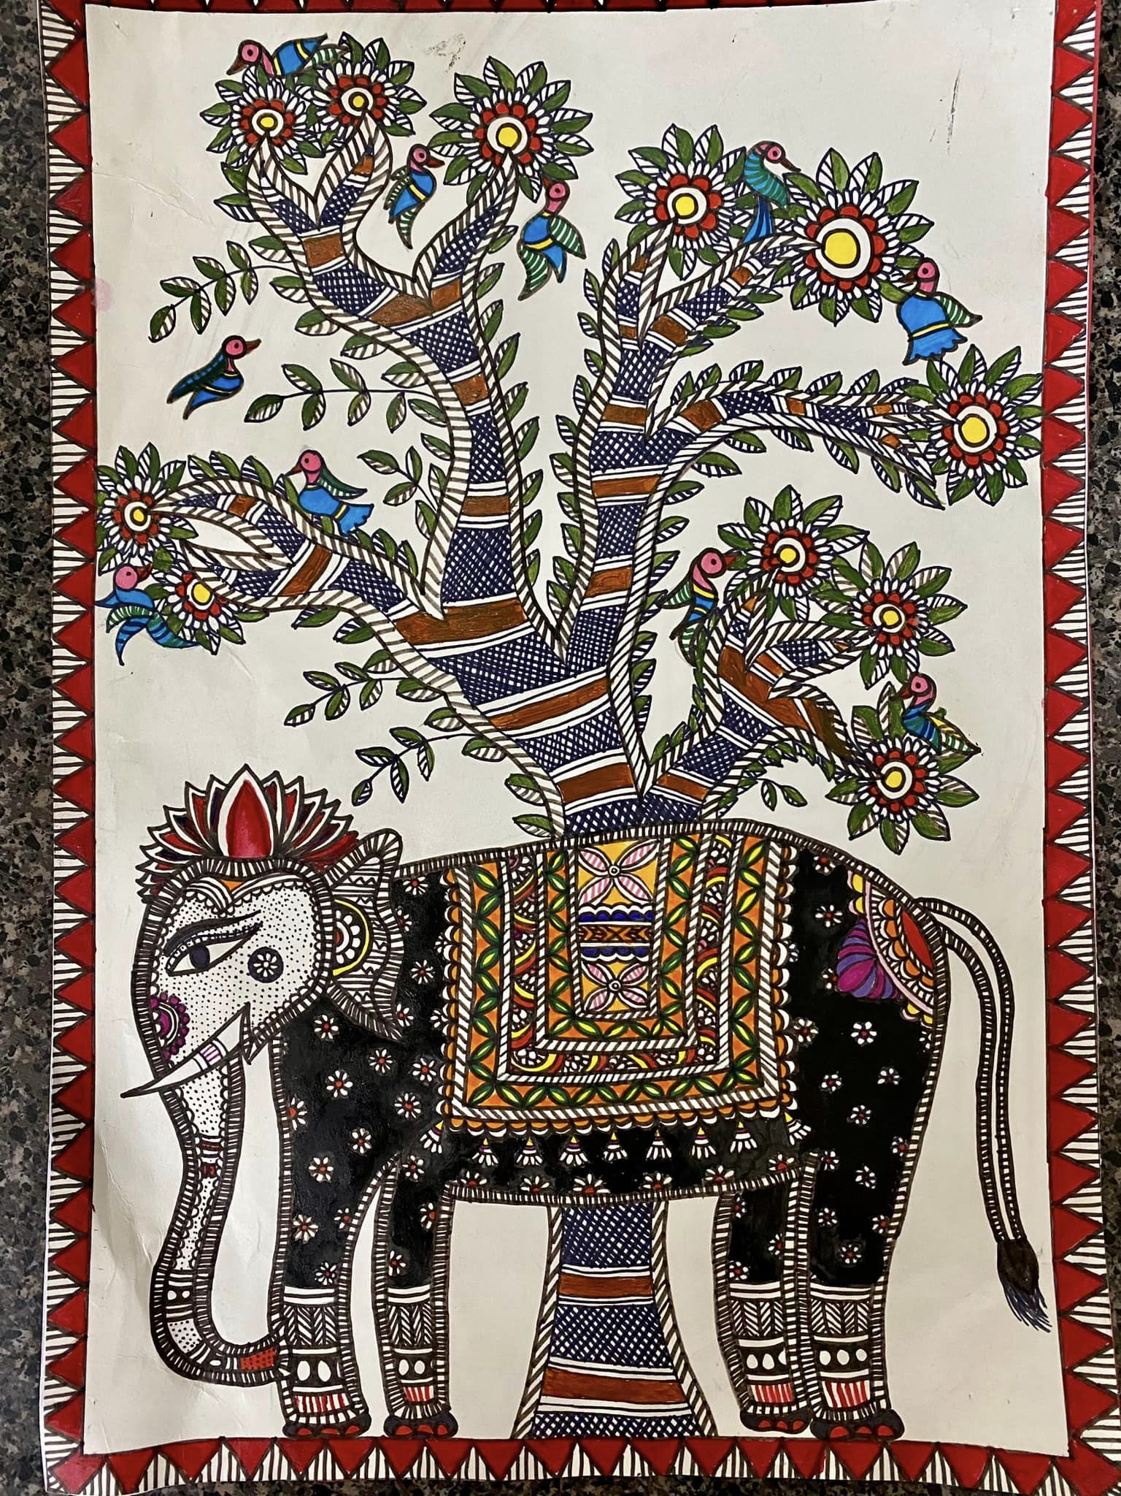
Amazing artworks from the students

Slide 7
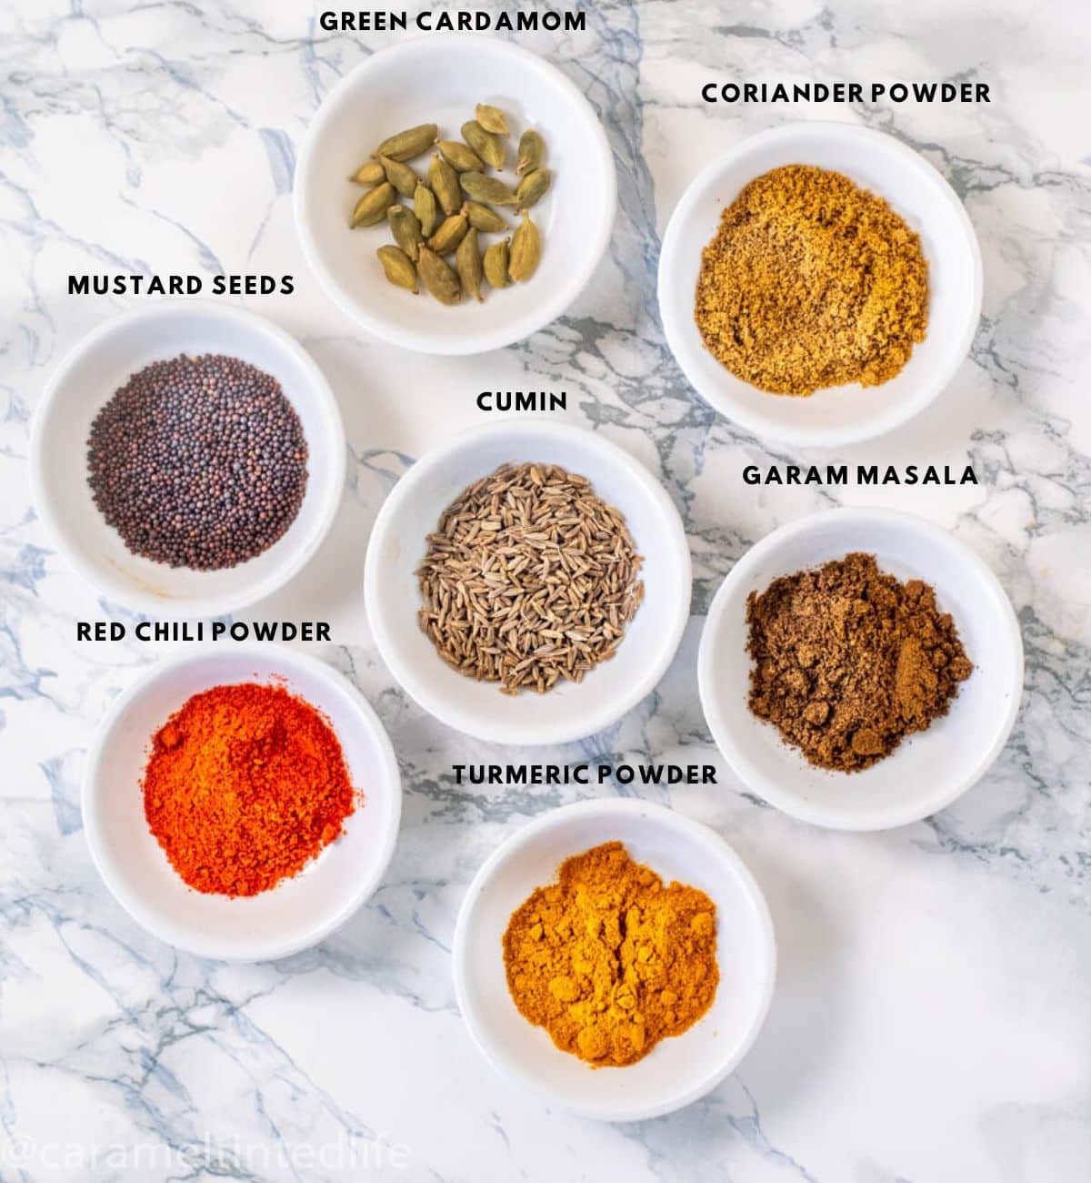

Example: What is Golden Milk?

Slide 8
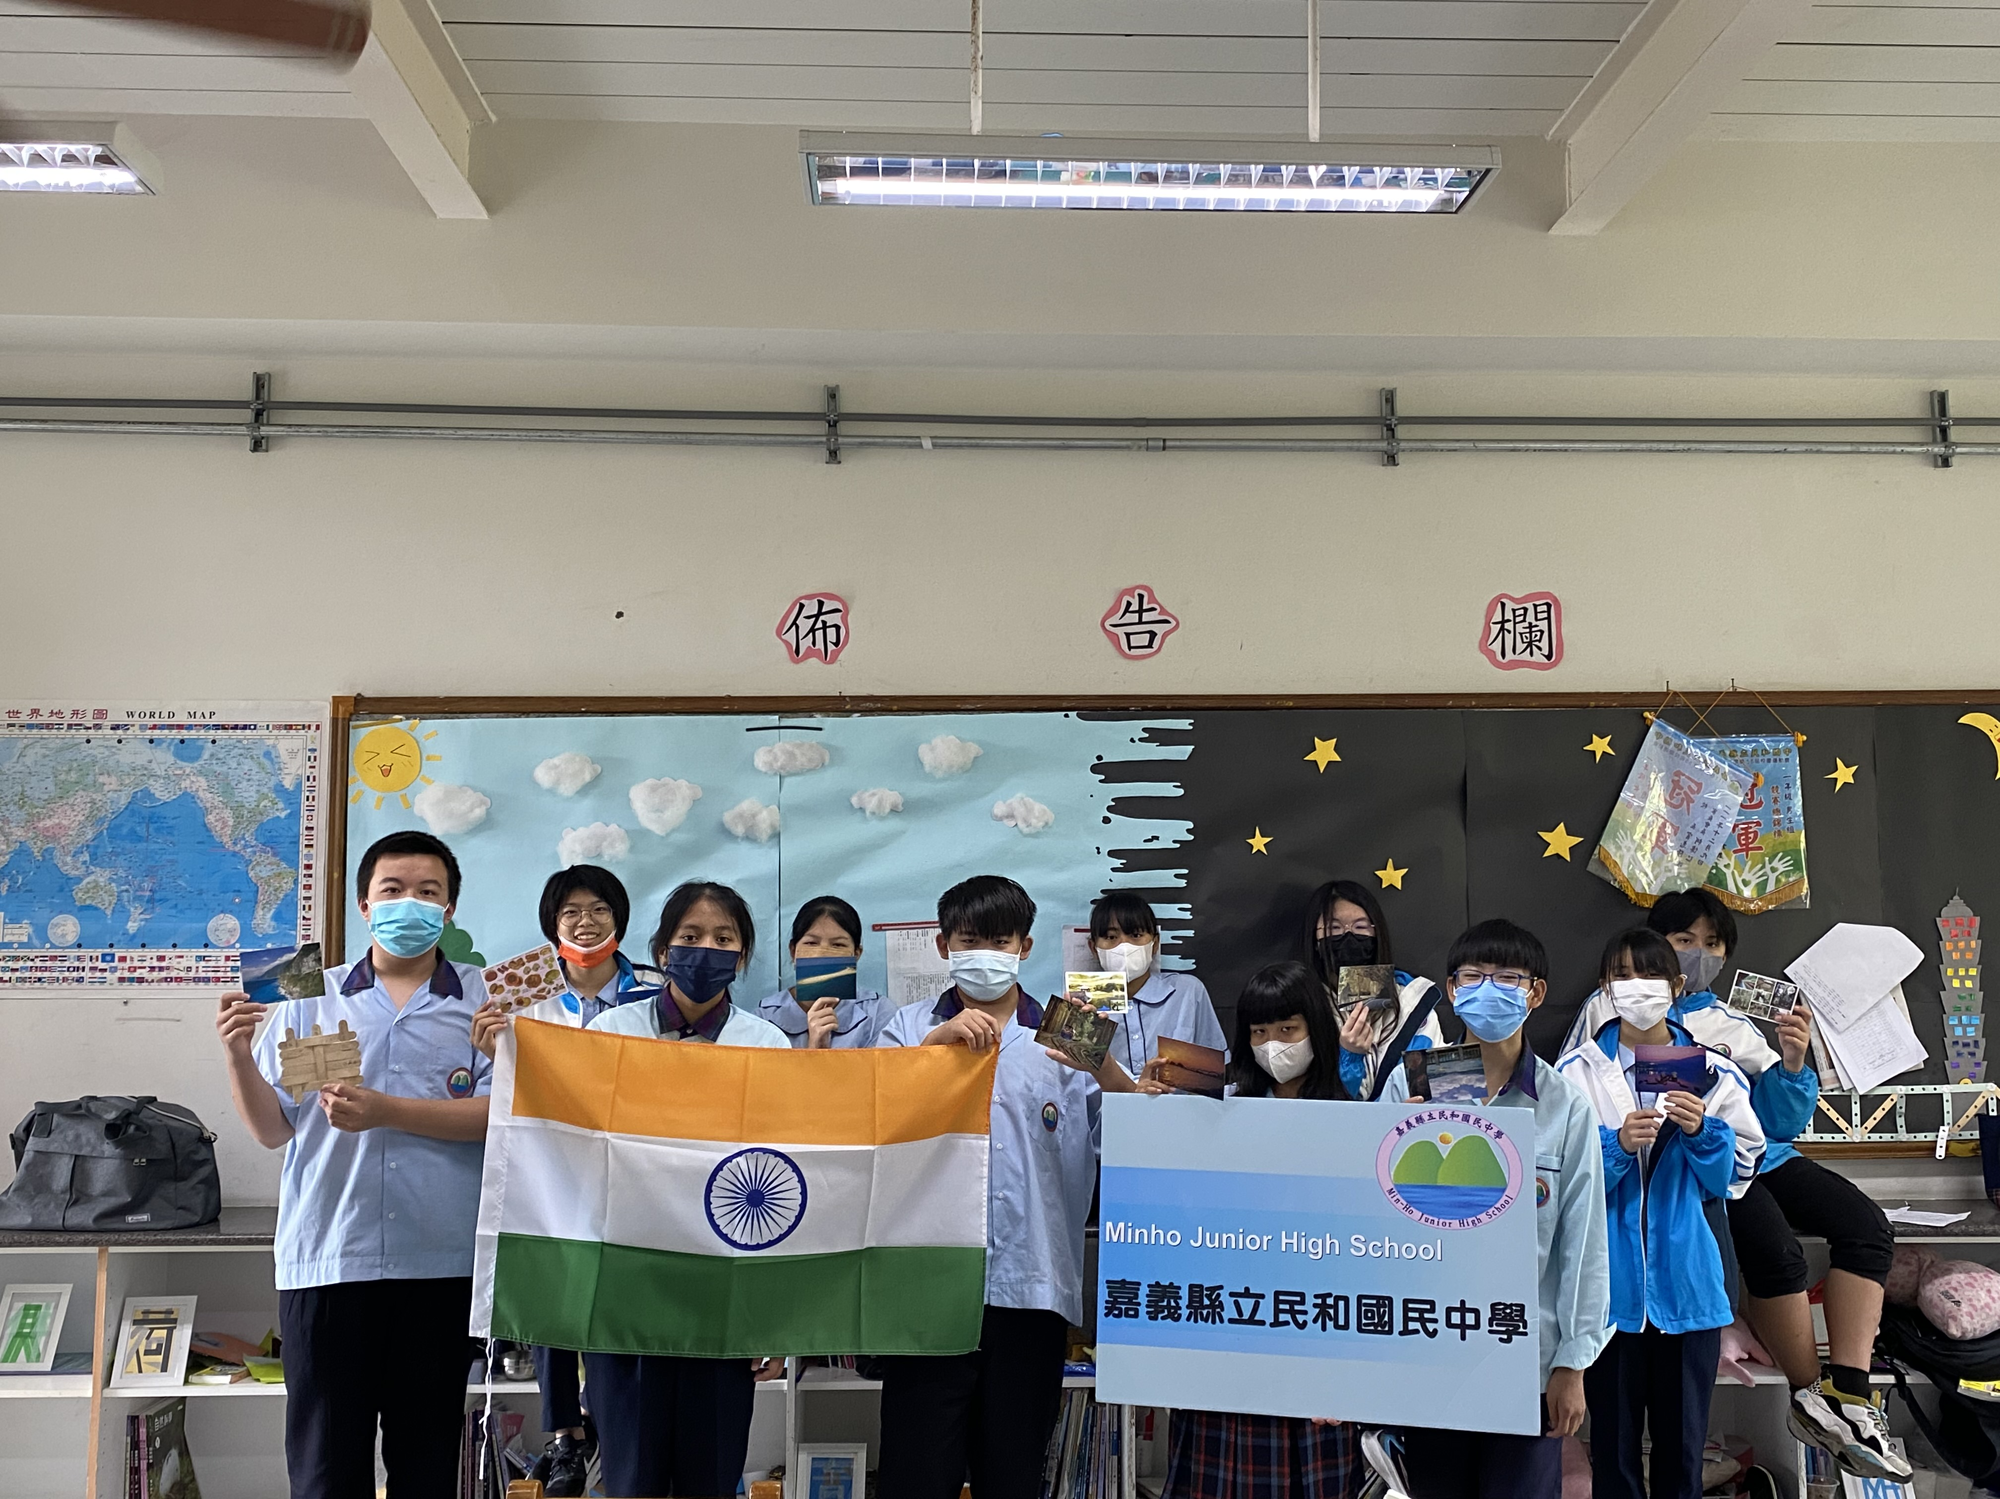
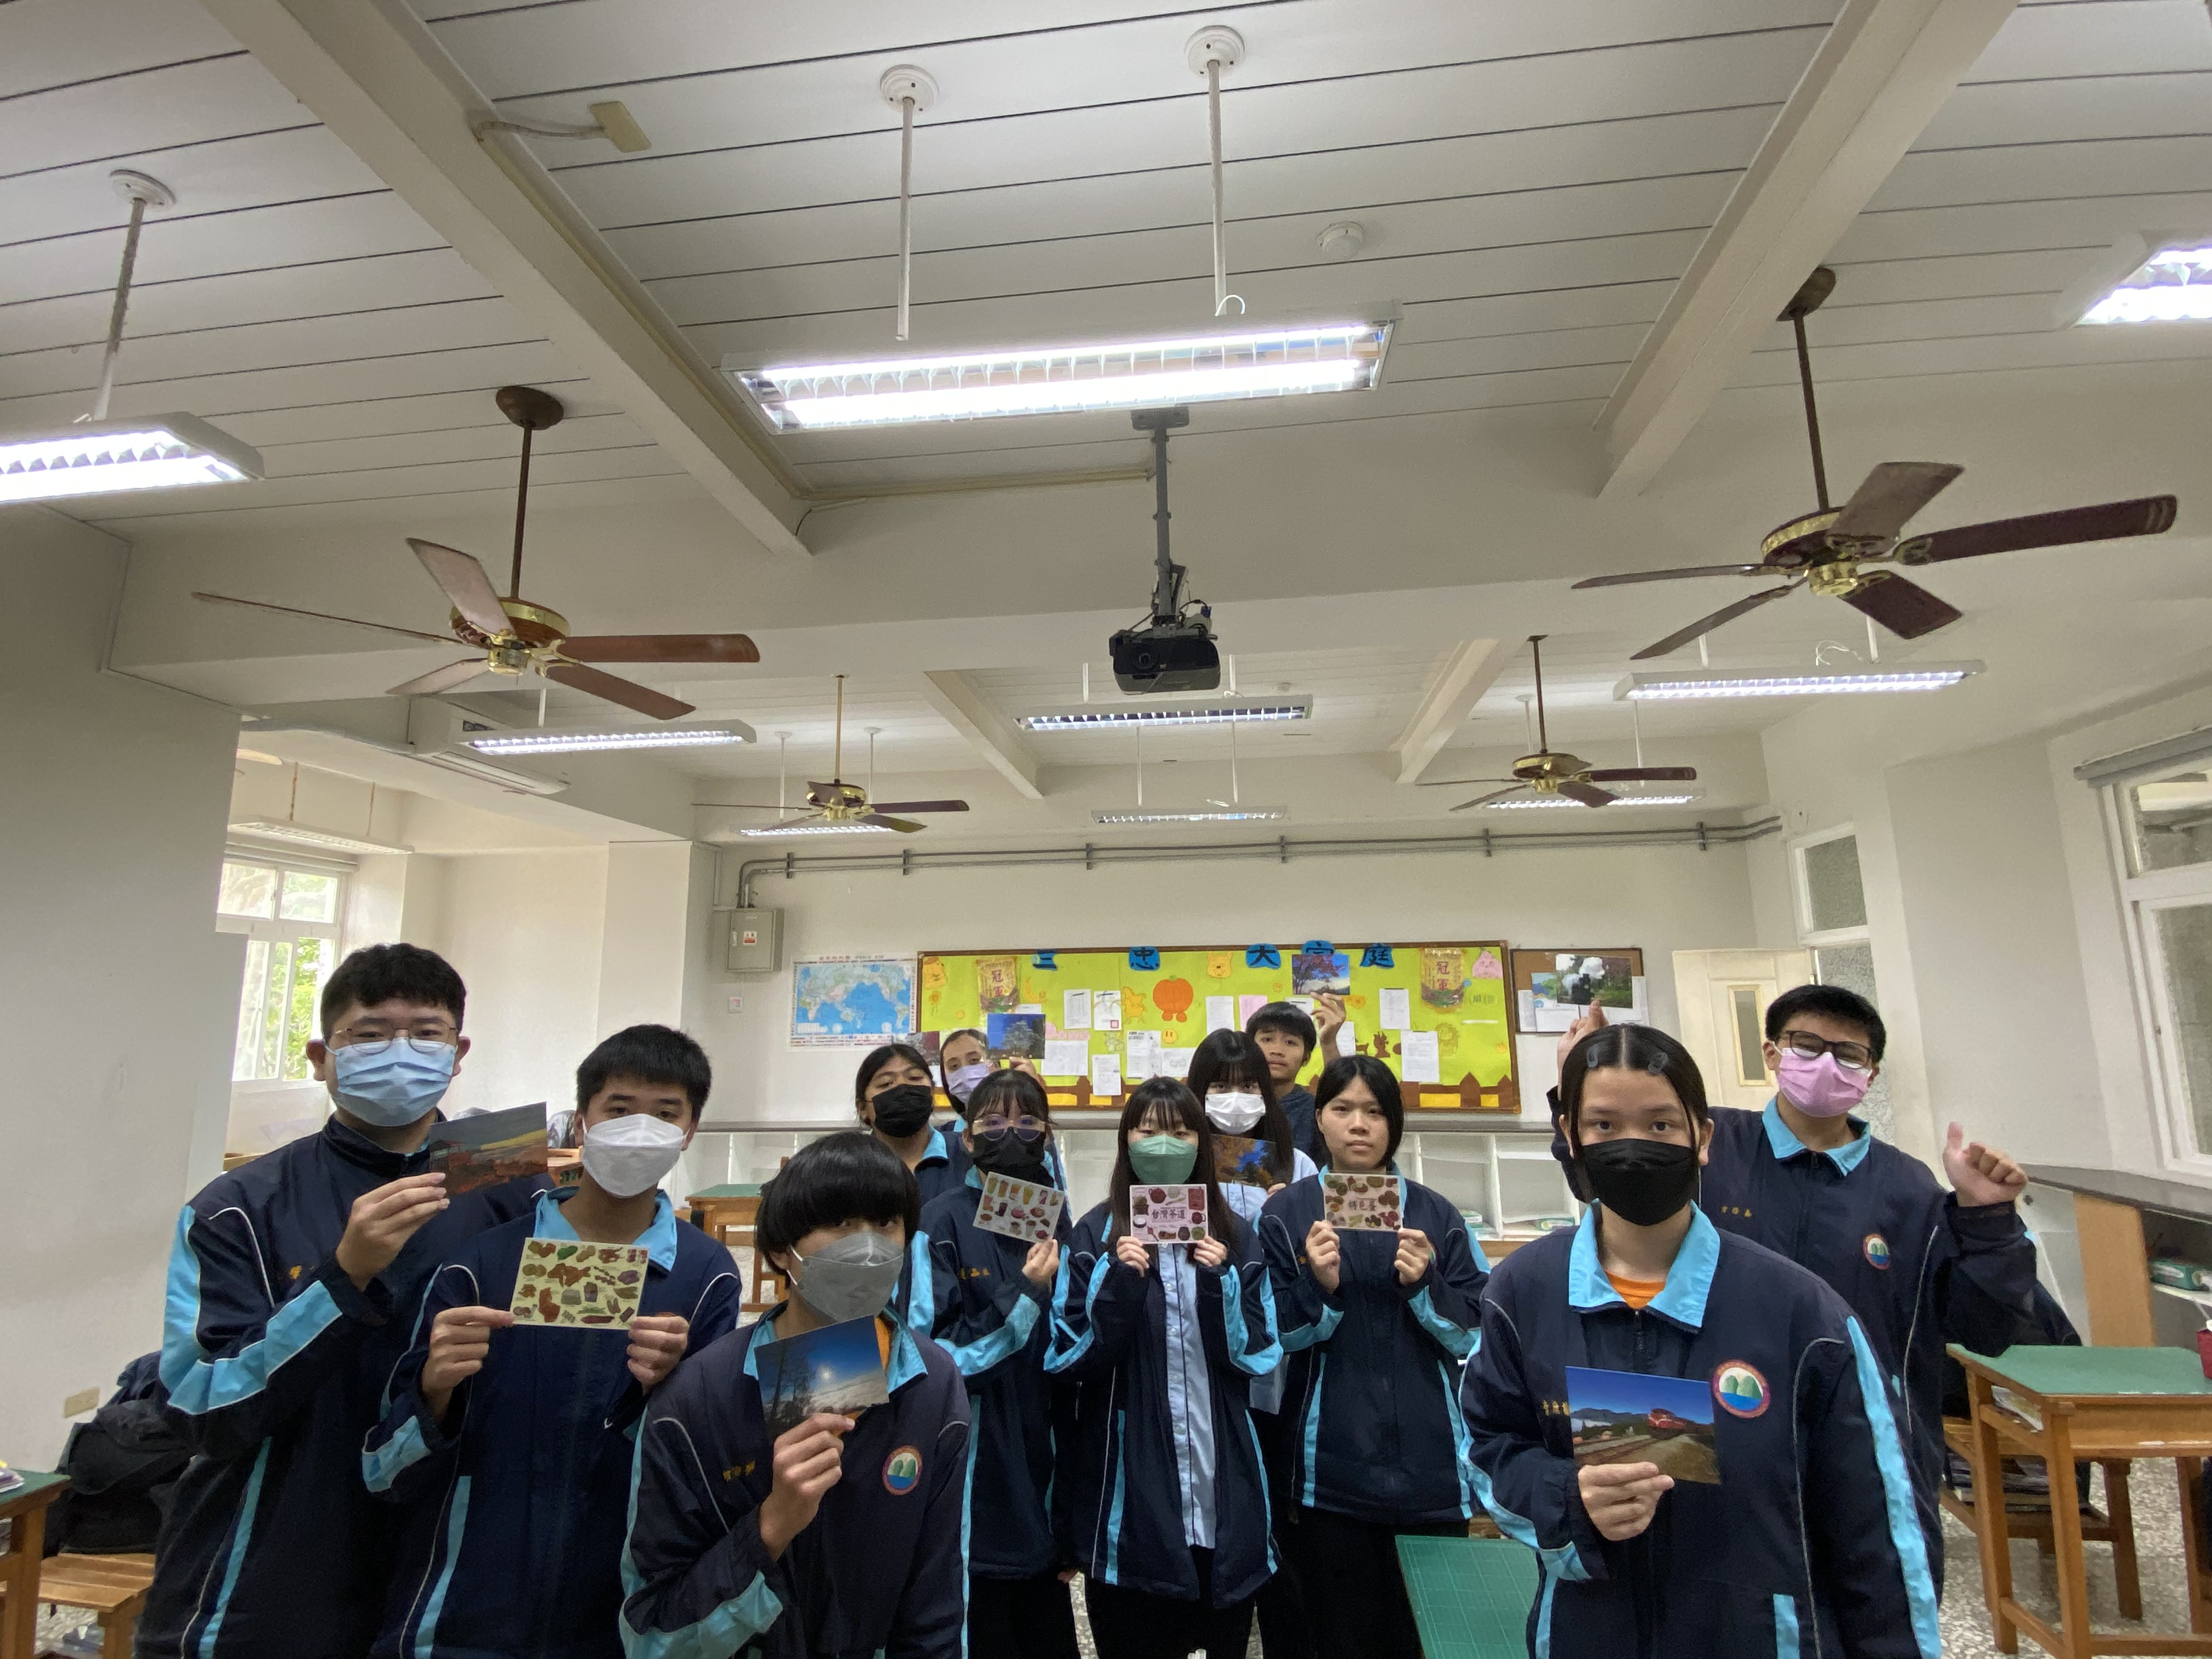
本校學生已錄製影片感表達感謝，也結合特色課程寄出在地的明信片，介紹台灣特色與嘉義番路的風土人情，進行文化交流。

Slide 9
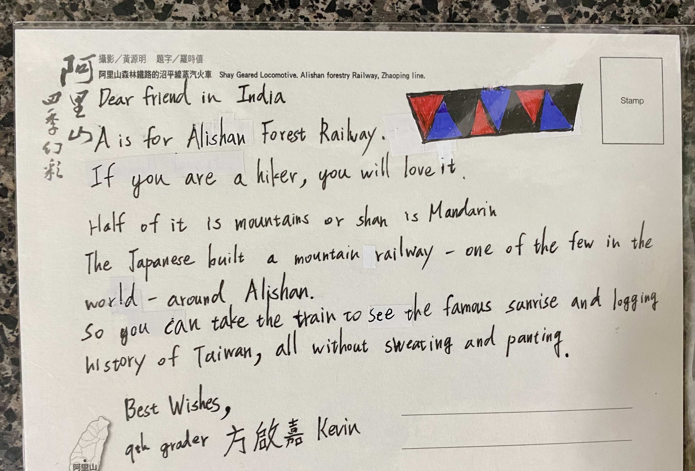
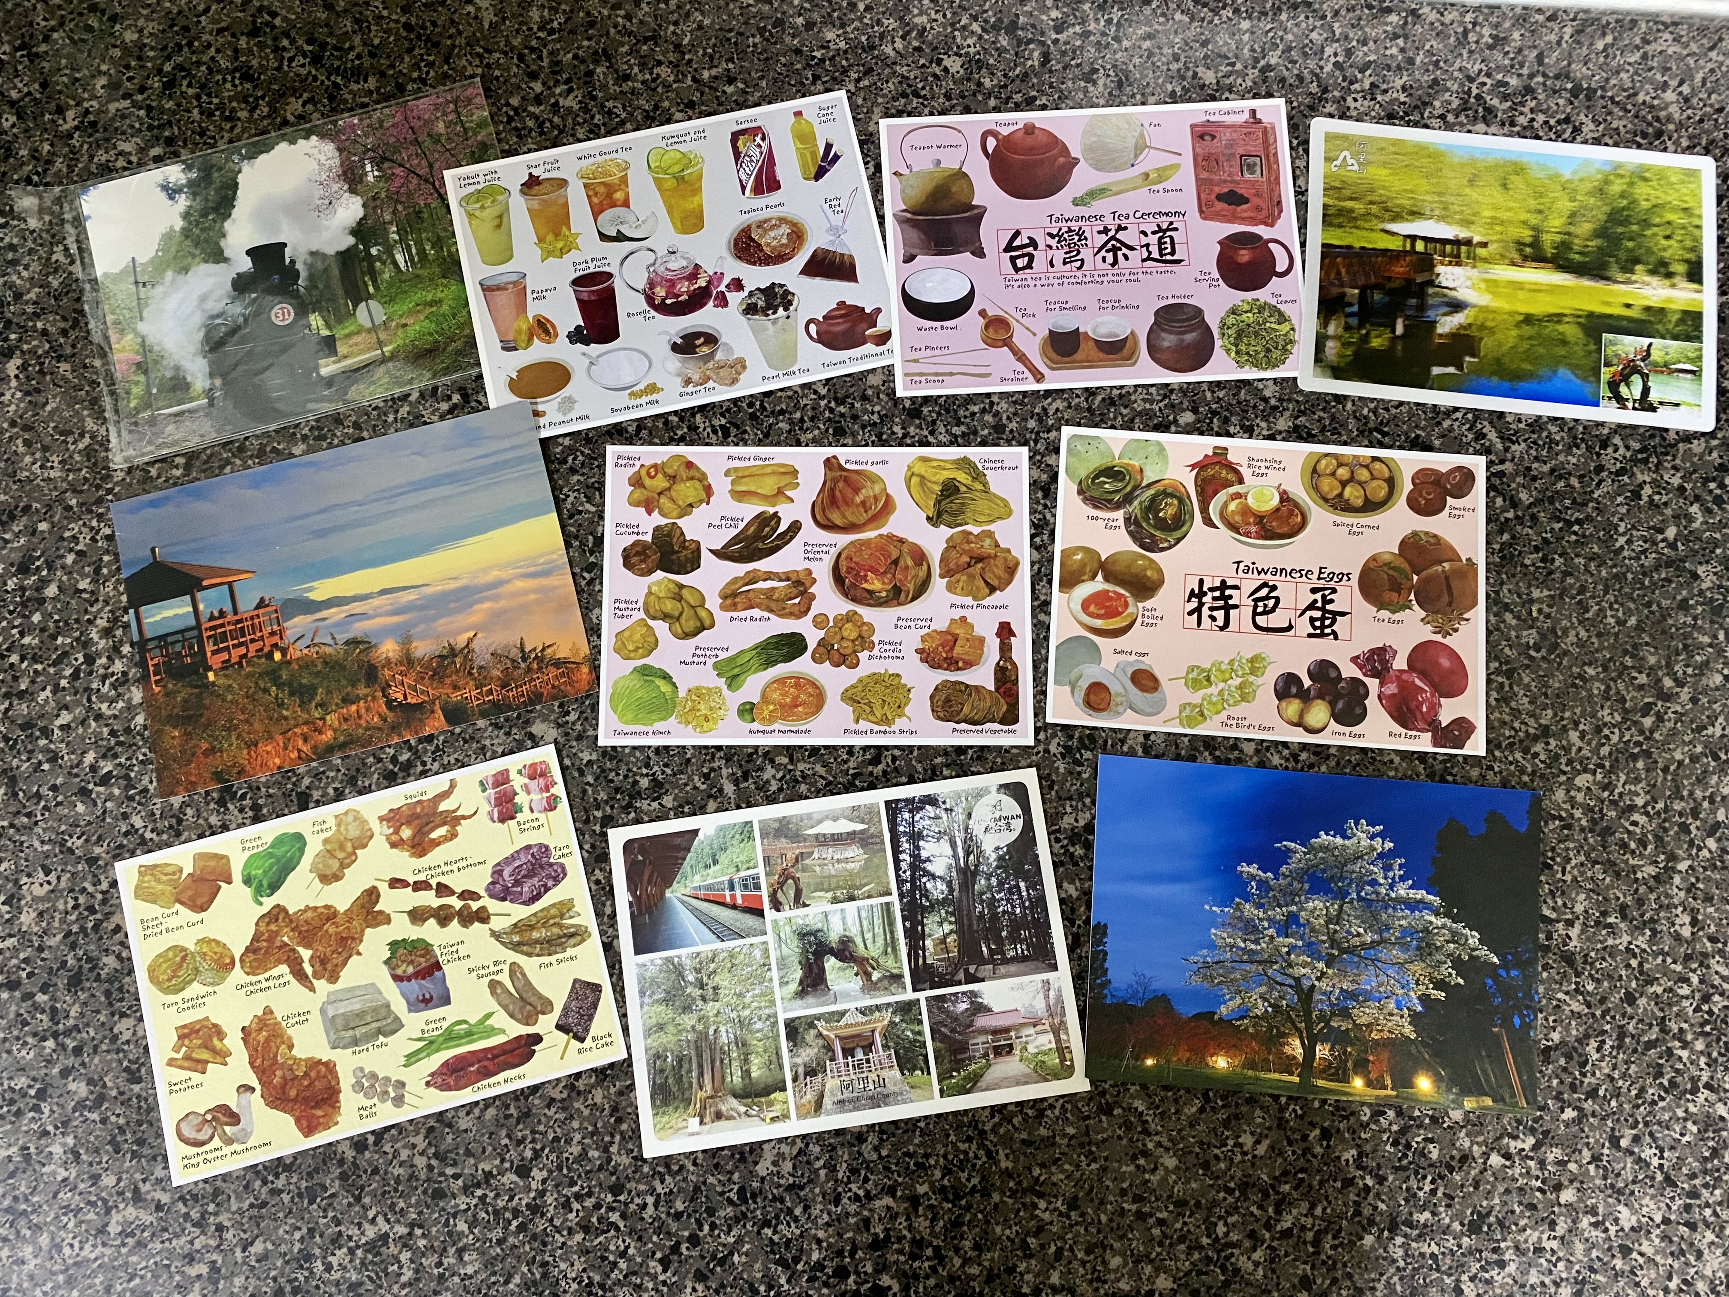

Slide 10
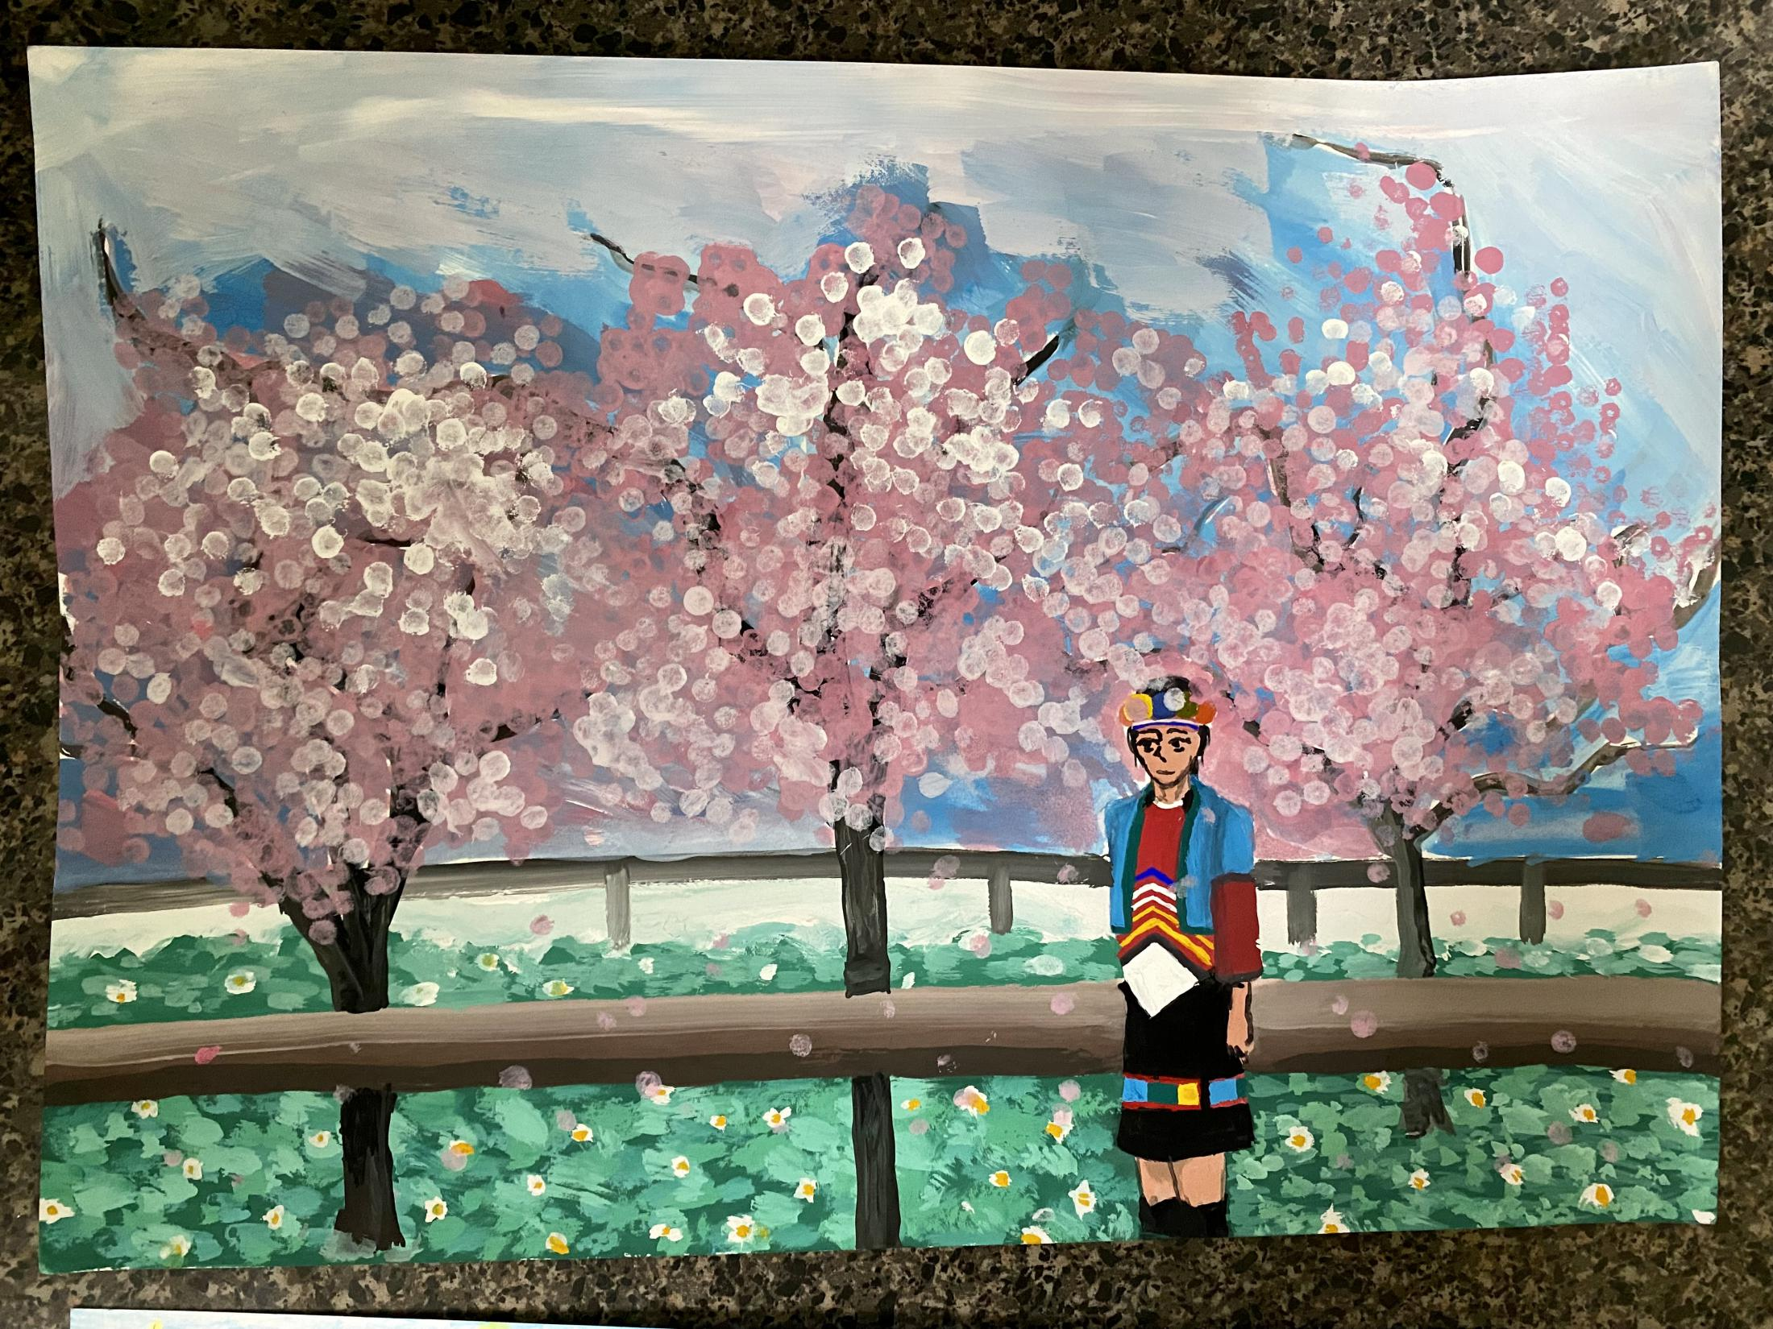
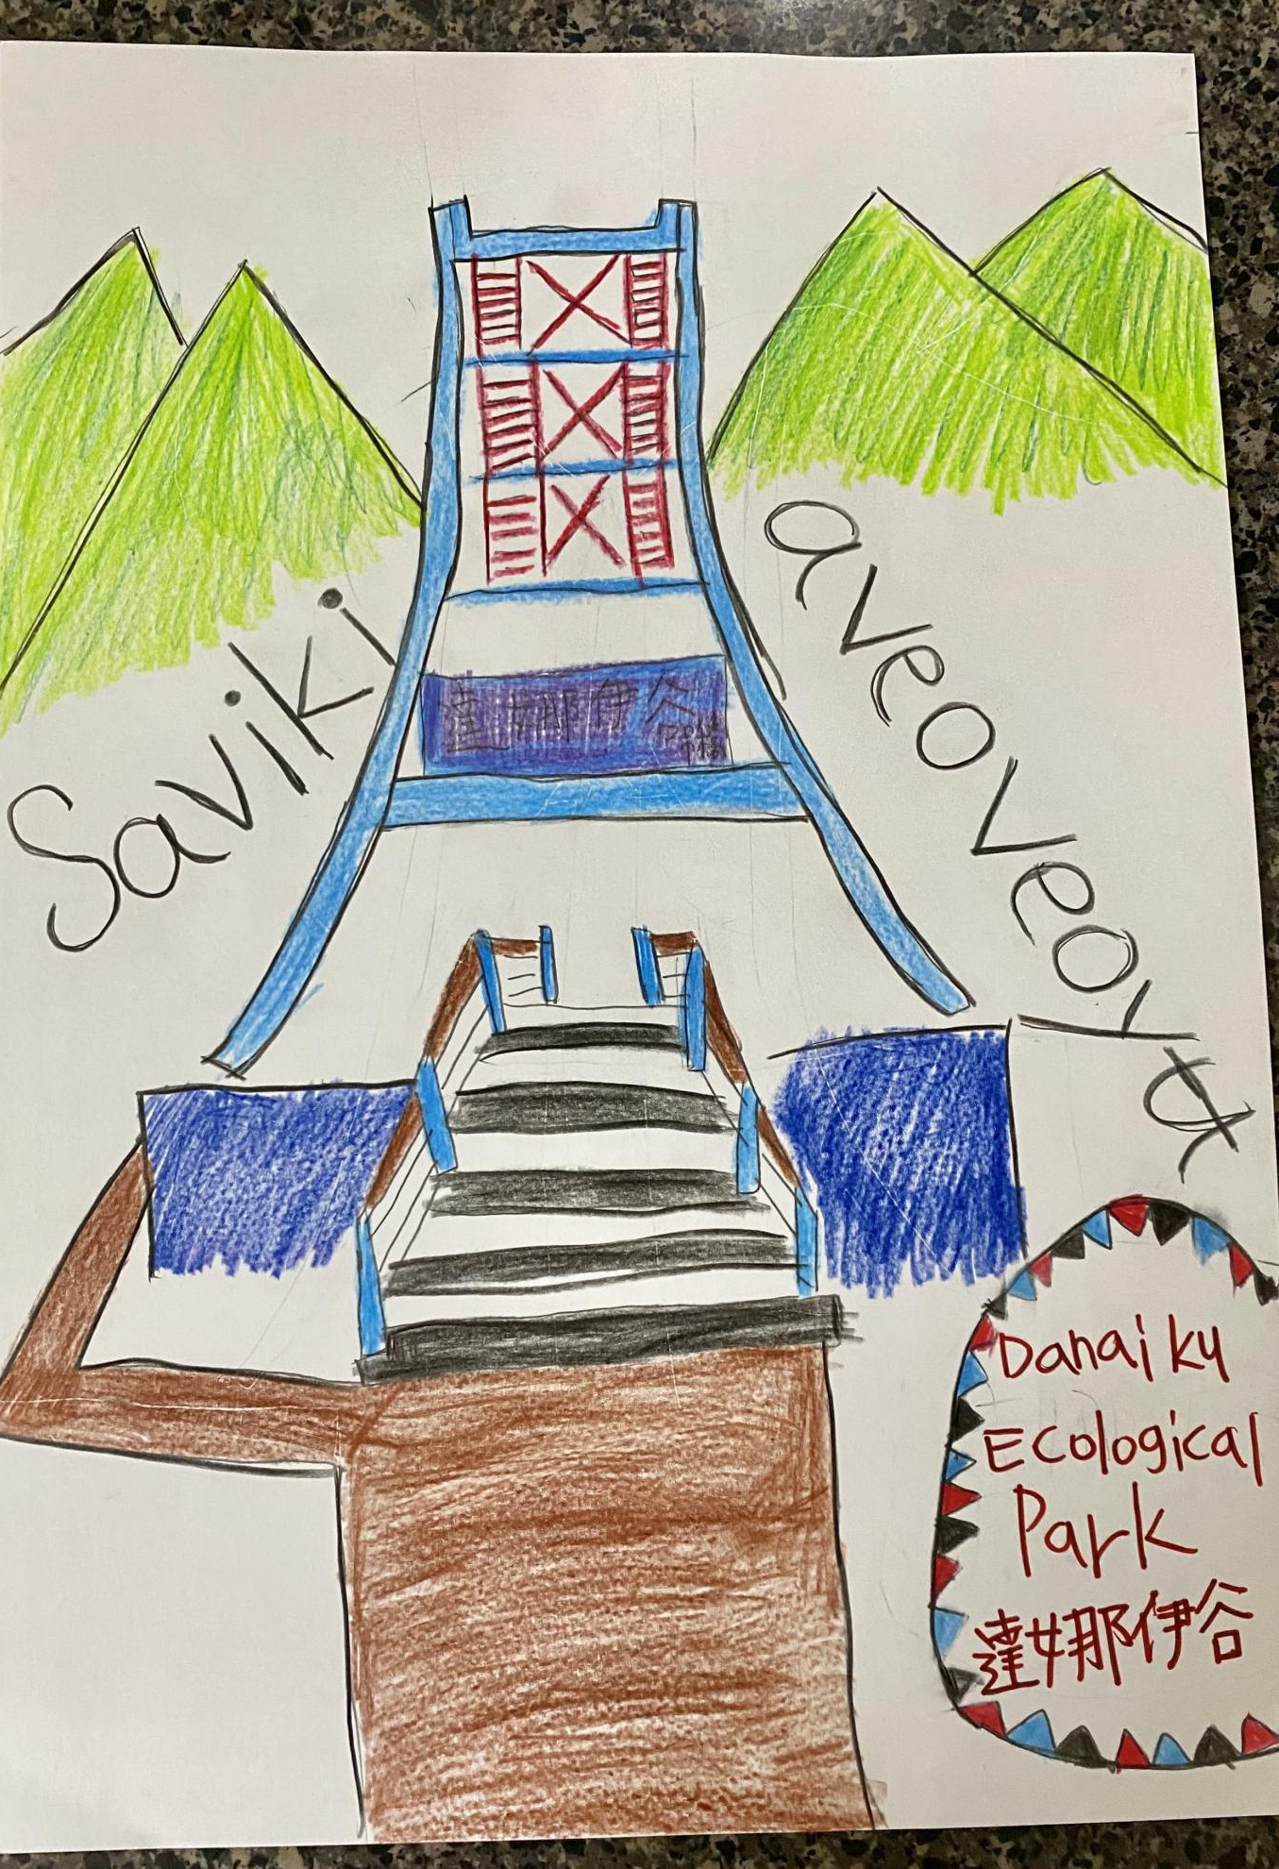
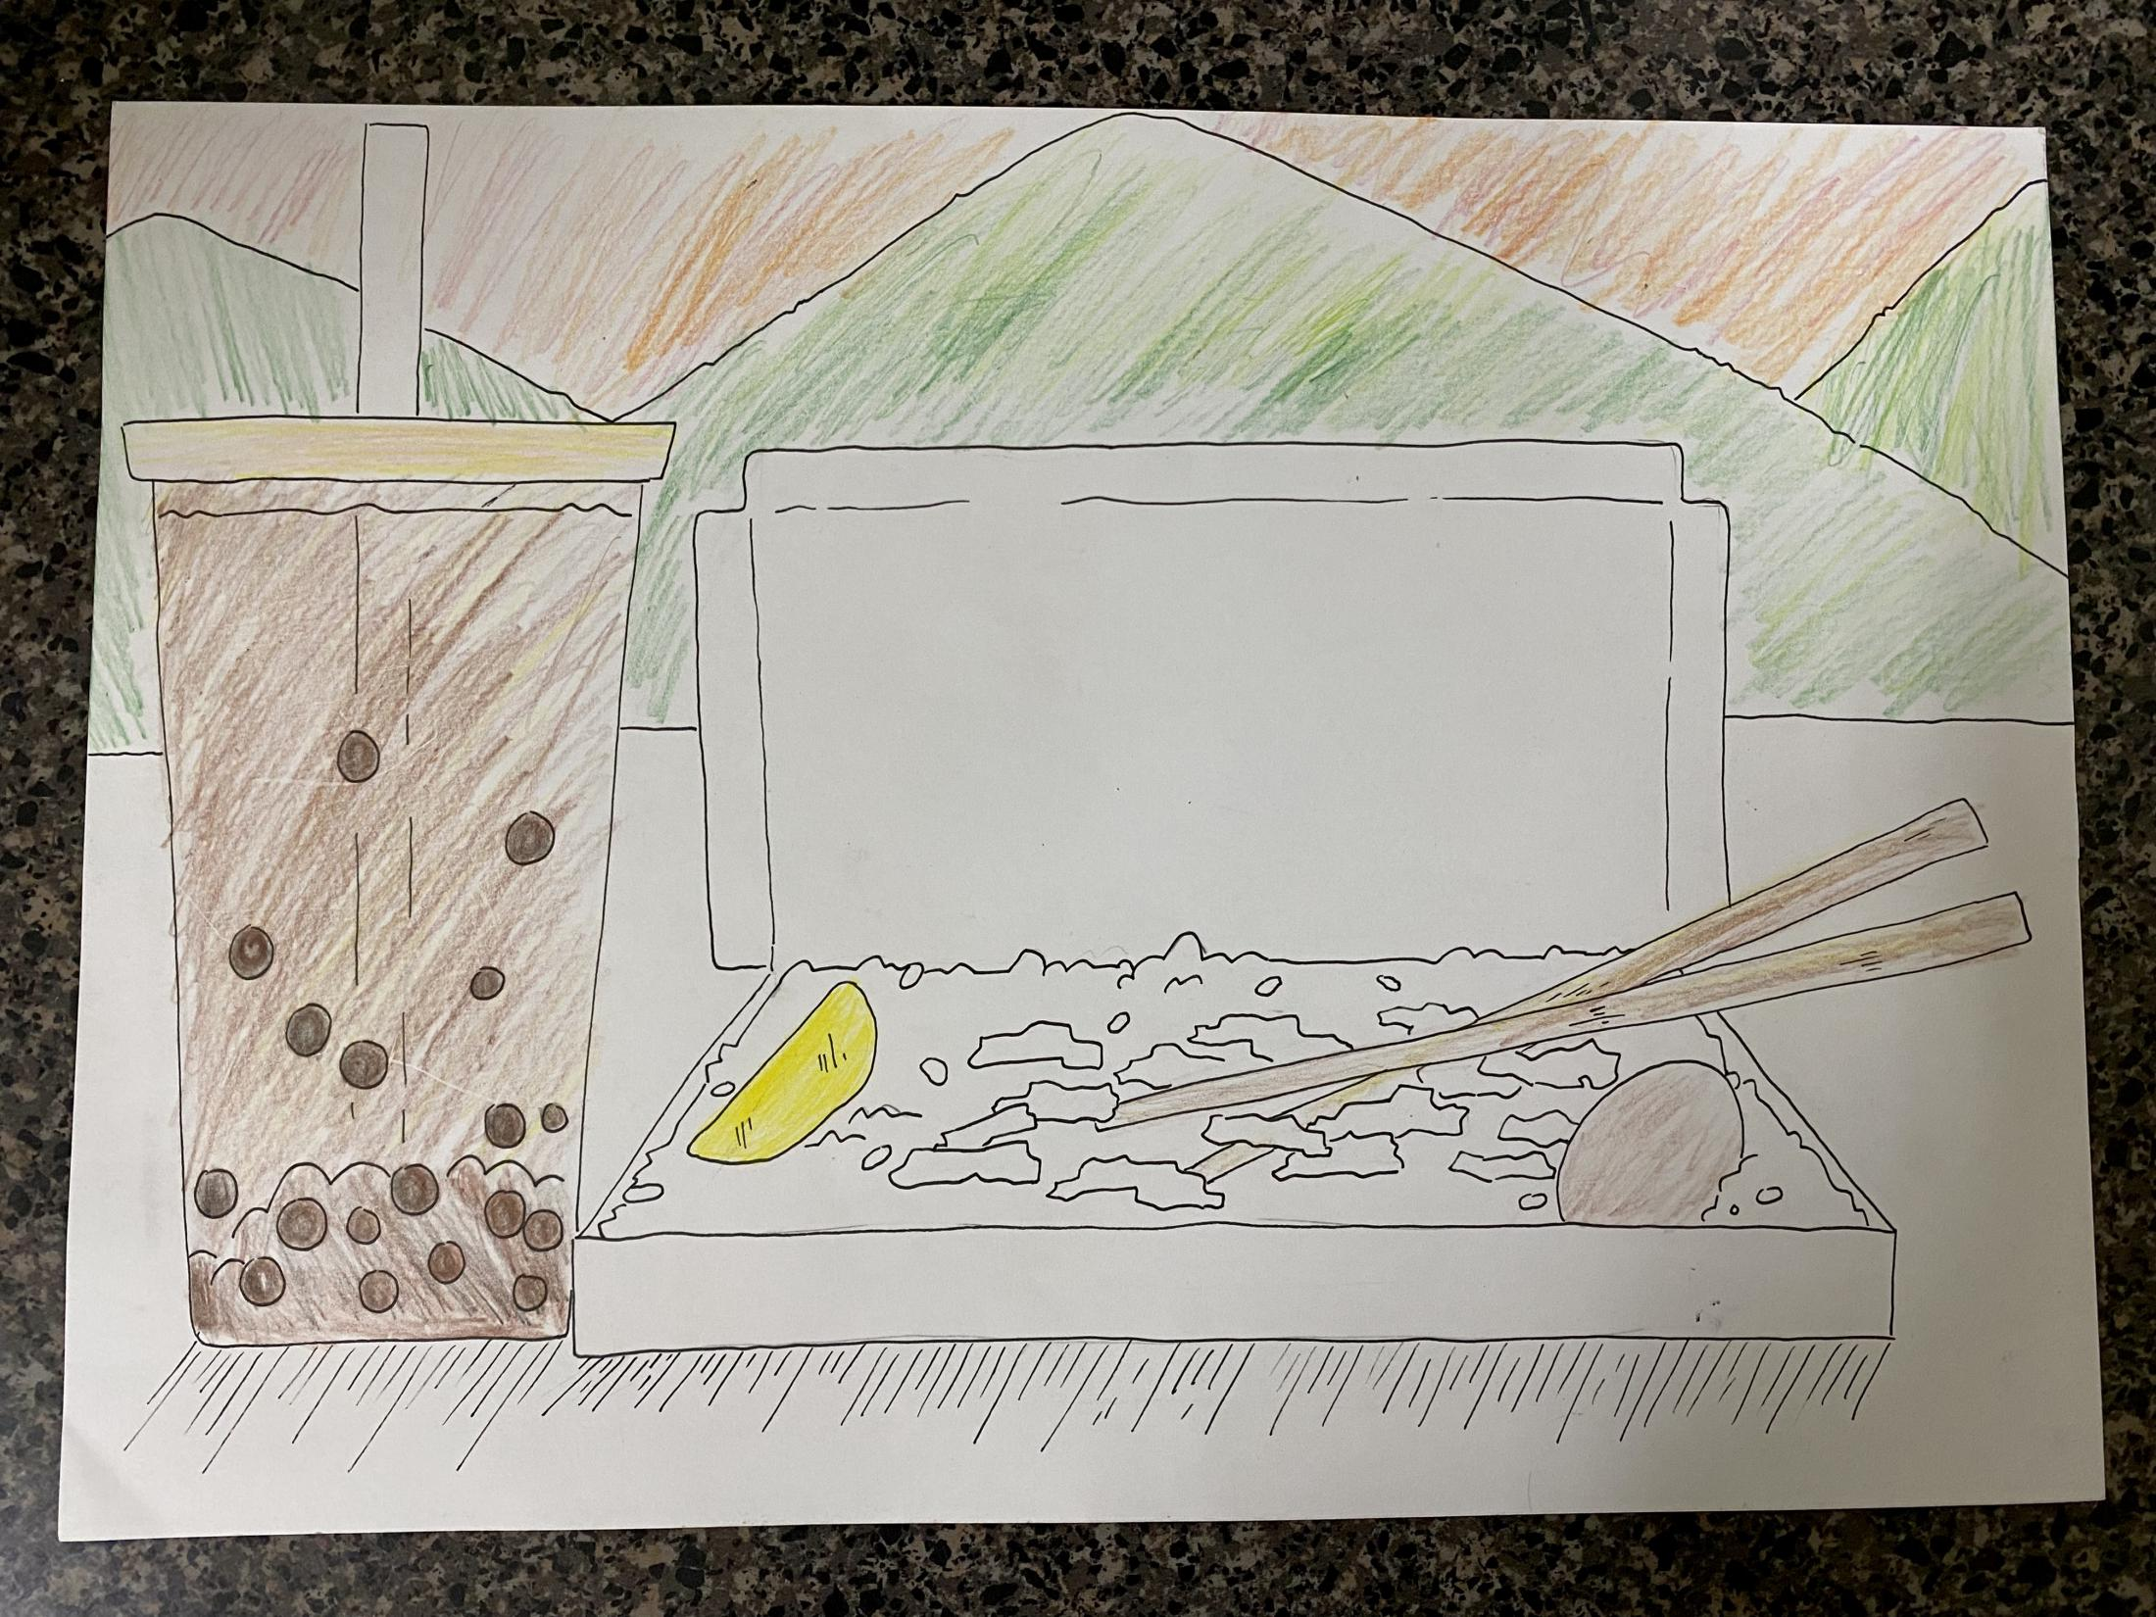
Cherry Blossom in Alishan mountain
turkey rice and pearl milk tea

Slide 11

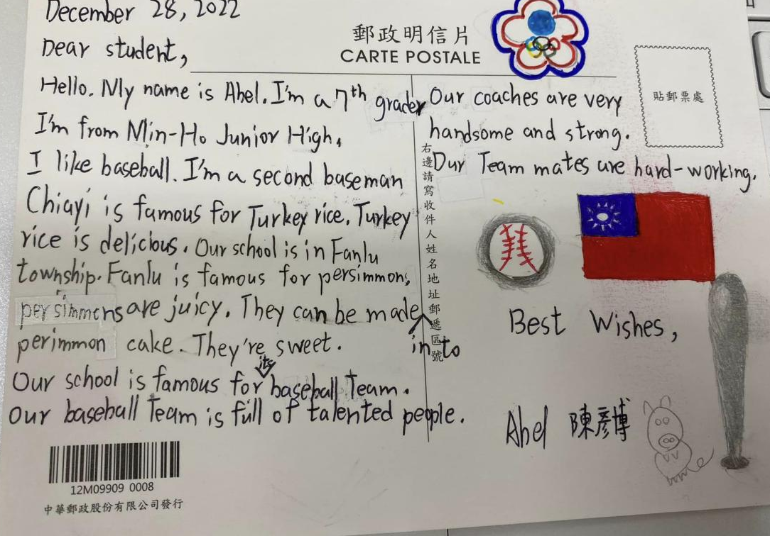
Baseball team

Slide 12
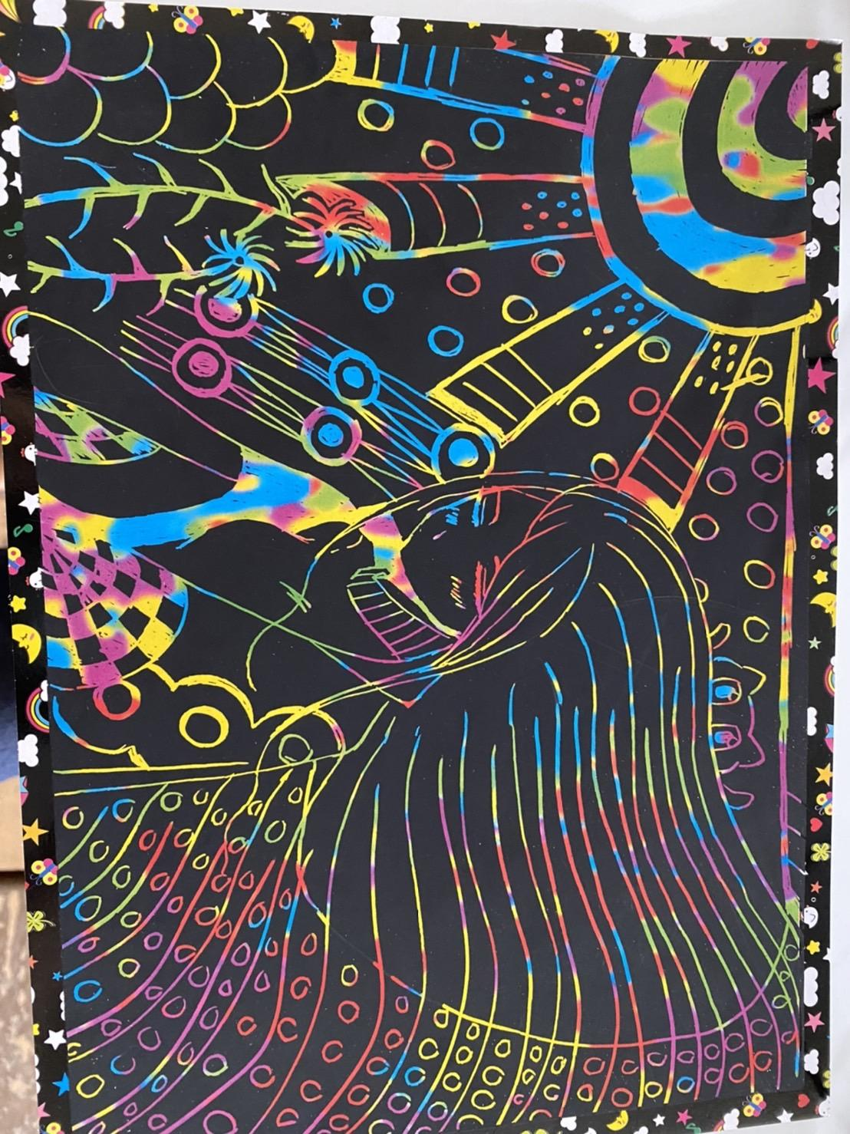
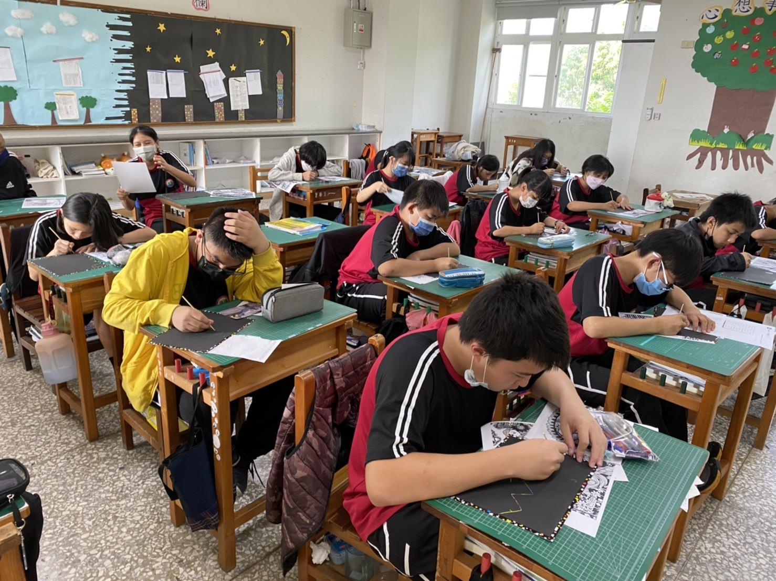
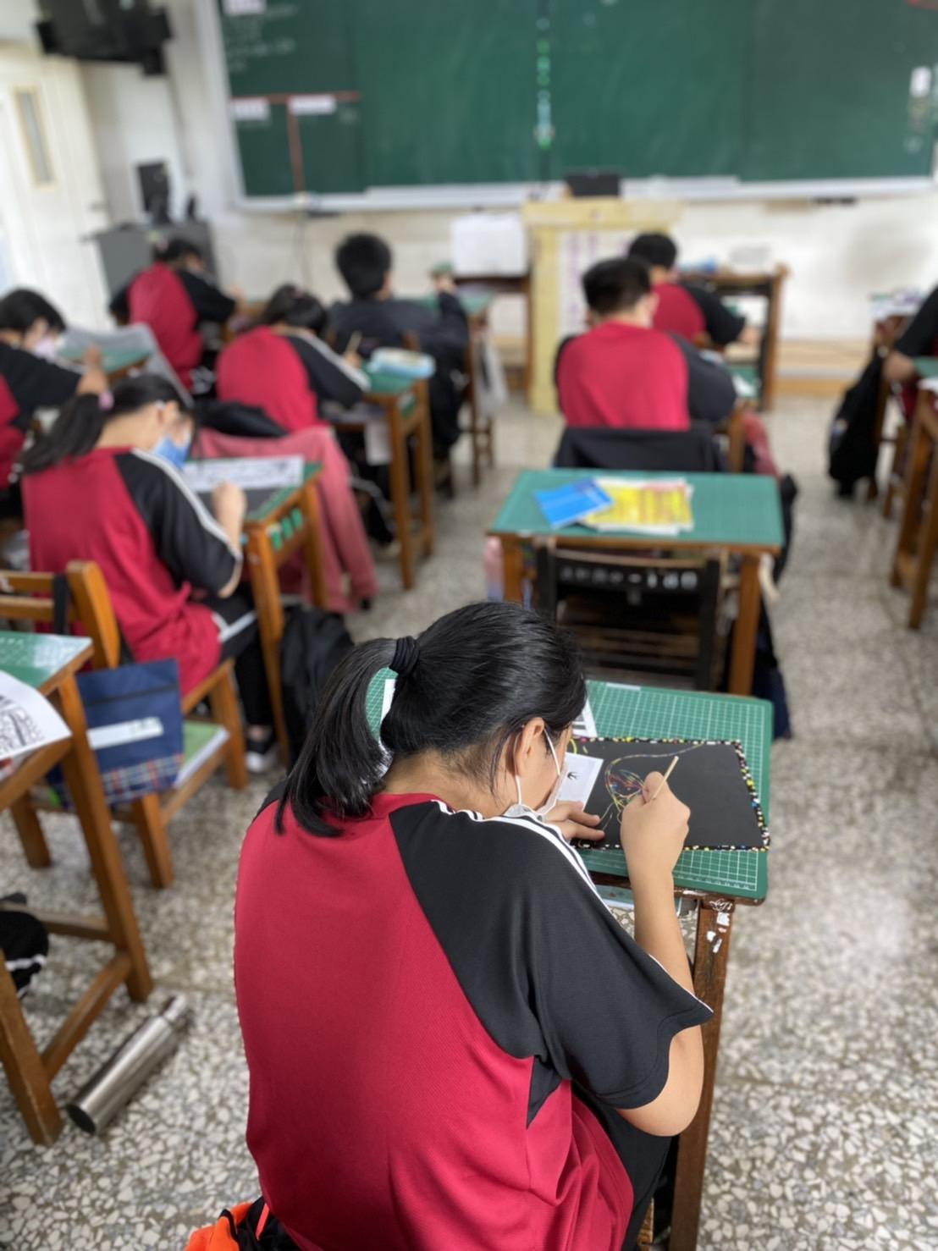
未來展望

Slide 13
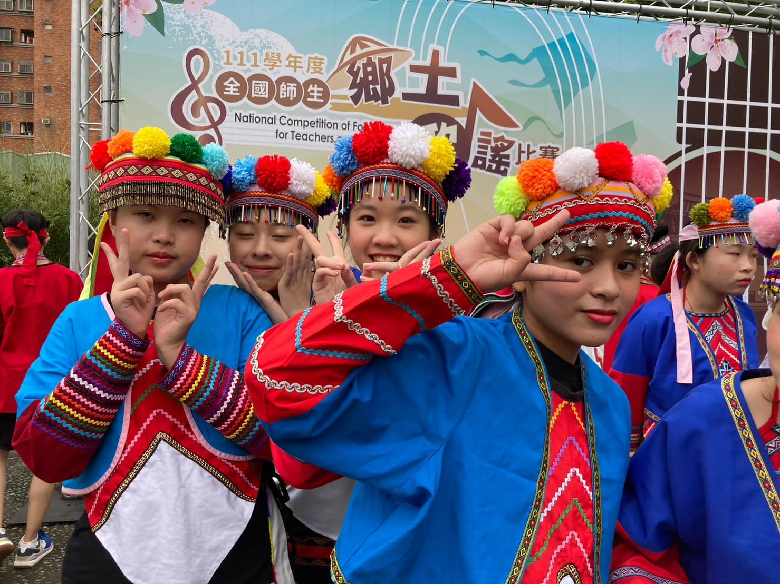
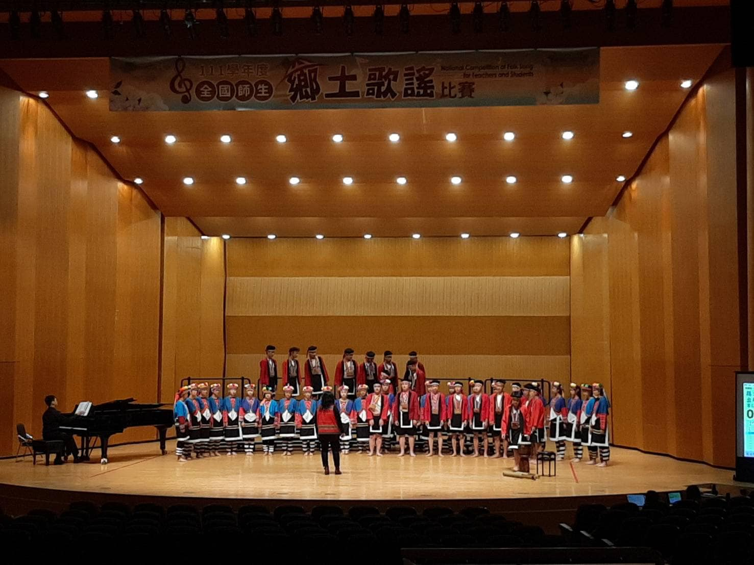
Culture Exchange:
Traditonal Dance and Music
https://www.youtube.com/watch?v=BFgvwy54yhY
SDGs Lessons

Slide 14
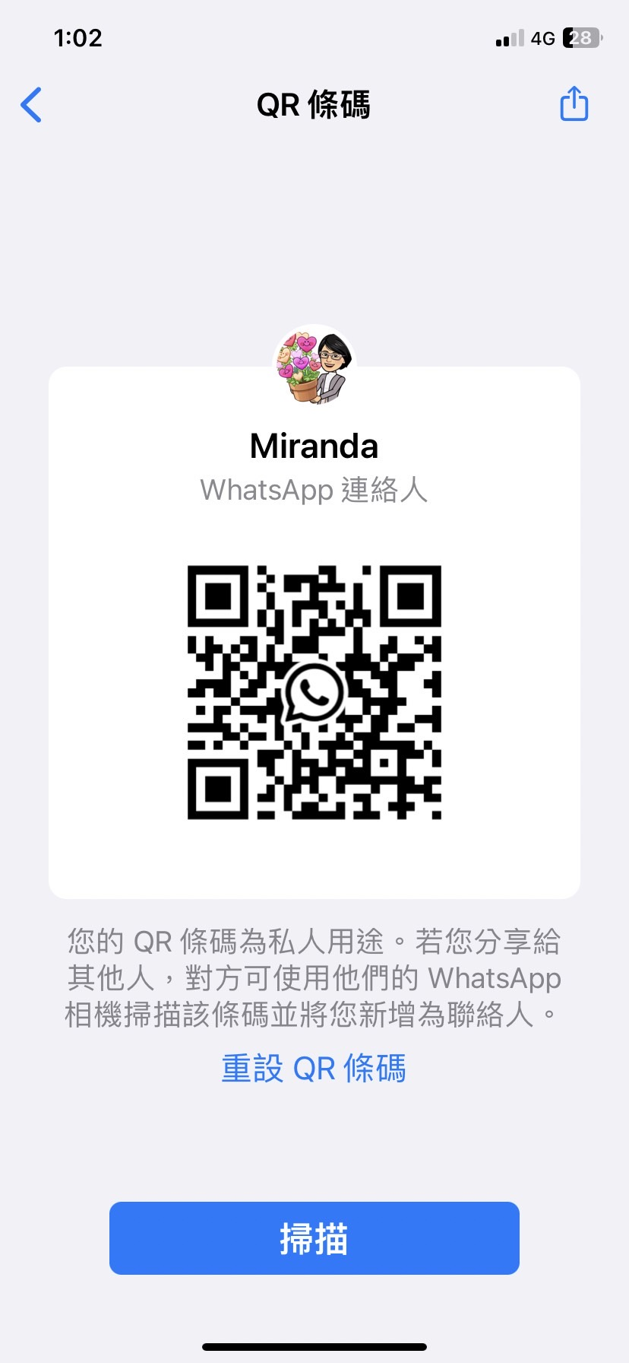
Bridge the Real World into the Classroom
email :edithmonster@gmail.com
Miranda Li

